Slide 1

Elementų kūrimas su JS ir pridėjimas į HTML
Aistė Župerkaitė
2021
JavaScript programavimo kalba

Slide 2
Šiandien išmoksite
JavaScript programavimo kalba
01
document.createElement()
02
element.append()
03
element.prepend()

Slide 3
createElement()
document.createElement()
- Metodas createElement() sukuria HTML elementą pagal jo žymos pavadinimą (tagName);
- Pavyzdys:
const paragraph = document.createElement('p') > sukurs paragrafo žymą HTML'e.
console.log(paragraph) > grąžins HTML elementą;

Slide 4
append()
document.append()
Svarbu! append() metodą galima taikyti ne tik visam dokumentui, bet ir kitiem elementam, į kuriuos tiesiogiai norime kažką patalpinti.
Svarbu! append() metodas pridės elementus į tėvinio elemento galą.
Pvz. Nr. 1
Sukuriame div elementą:
let box = document.createElement("div");
Į div elementą tiesiogiai pridedame tekstą:
box.append("Some text");
Pvz. Nr. 2
Sukuriame h1 elementą ir pridedame jam teksto:
const greeting = document.createElement("h1");
greeting.textContent = "Laba diena";
Patį h1 elementą įdedame į HTML body
document.body.append(greeting);

Slide 5
prepend()
document.prepend()
Svarbu! append() metodas pridės elementus į tėvinio elemento priekį, prieš kitus elementus.
Pvz. Nr. 1
Sukuriame div elementą:
let box = document.createElement("div");
Į div elemento galą tiesiogiai pridedame tekstą:
box.append("Some text");
Į div elemento priekį, tiesiogiai pridedame tekstą:
box.prepend("Headline: ")
Rezultatas:
Headline: Some text

Slide 6

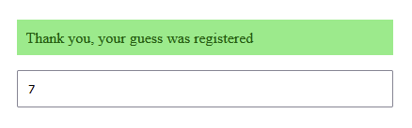
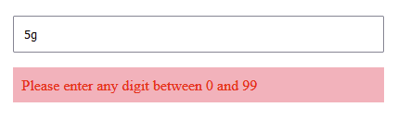
Create, append and prepend
Practice Time
1. Get the starter code here - codepen;
Please – do not work on this codepen workspace! Copy starter code in your editor, jsitor or your own codepen.
2. Your goal is to determine if value is number and if it's between 0 and 99 inclusive on blur event and create and style an element with Javascript accordingly:
- if conditions are true (it's a number which is between 0 and 99) -
show styled success message above the input.
- if conditions are false (not a number or lower than 0 or higher than 99) -
show styles error message below the input.
- each time blur event happens, the previous message bust be cleared.

Slide 7
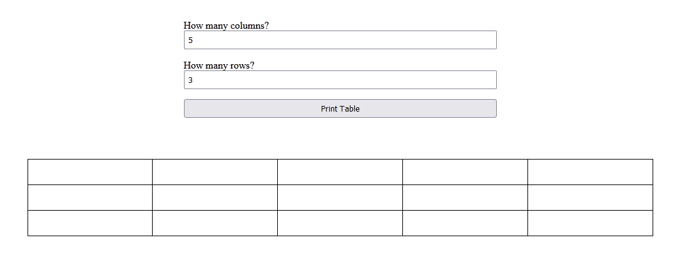
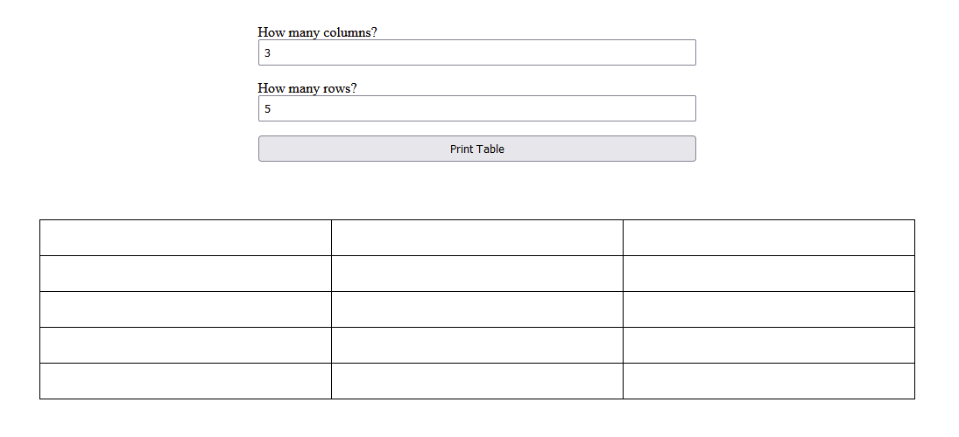
Create Table
Practice Time
1. Get the starter code here - codepen;
Please – do not work on this codepen workspace! Copy starter code in your editor, jsitor or your own codepen.
2. Your goal is to print the table according to the user inputs for rows and columns.
3. No additional validation will be written, however if you feel like validation the inputs – go ahead.

Slide 8
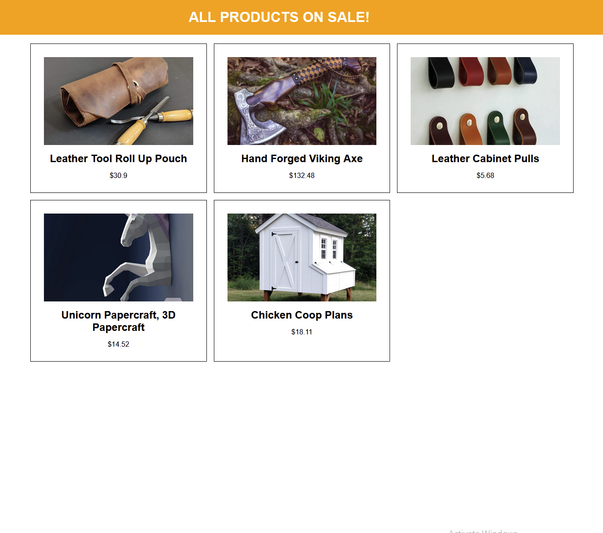
Print Products
Practice Time
1. Get the starter code here - codepen;
Please – do not work on this codepen workspace! Copy starter code in your editor, jsitor or your own codepen.
2. Your goal is to print the card for each product object dynamically. 3. You can only use Javascript to create and style all the elements.
4. Expected result example: small card for each object and its data

Slide 9
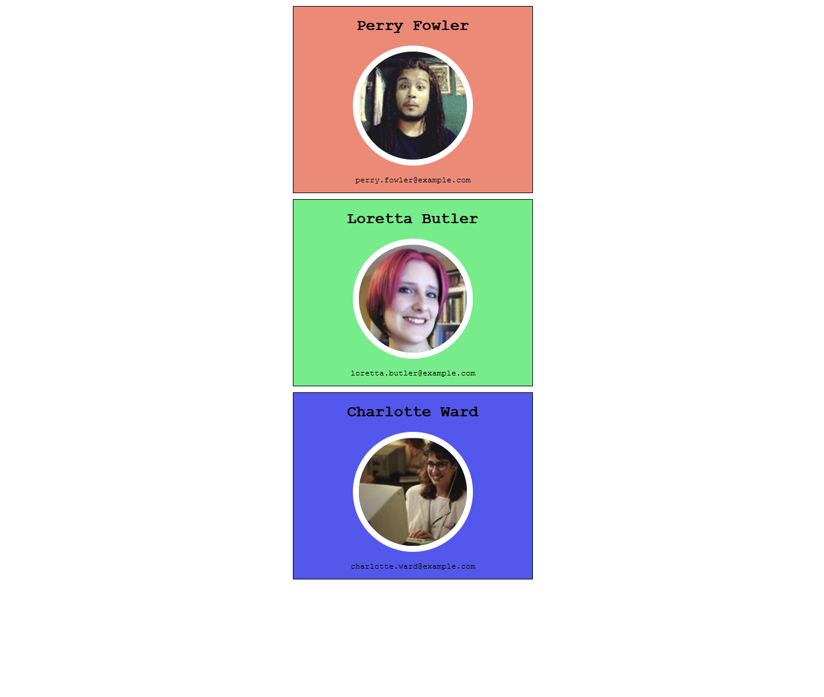
Print Ssers
Practice Time
1. Get the starter code here - codepen;
Please – do not work on this codepen workspace! Copy starter code in your editor, jsitor or your own codepen.
2. Your goal is to print the card for each user object dynamically. 3. You can only use Javascript to create and style all the elements.
4. Expected result example: small card for each object and its data

Slide 10
Naudinga informacija
JavaScript programavimo kalba
JavaScript
https://developer.mozilla.org/en-US/docs/Web/JavaScript

